Slide 1

The History of Business Strategy: An NLP Perspective
A natural-language-processing exploration of the thematic landscape of the field of Business Strategy, 1980-2020
General Assembly DSI-10 Showcase
April 9, 2020

Slide 2
Statement of business problem.
Essential problem. Detect major themes in published business-strategy literature.
Target Audience.
Business consultants.
Academic researchers.
Potential benefits.
Ability to provide more-insightful guidance to clients.
Better understanding of the body of research.
Opportunities to apply methods to other problems.

Slide 3
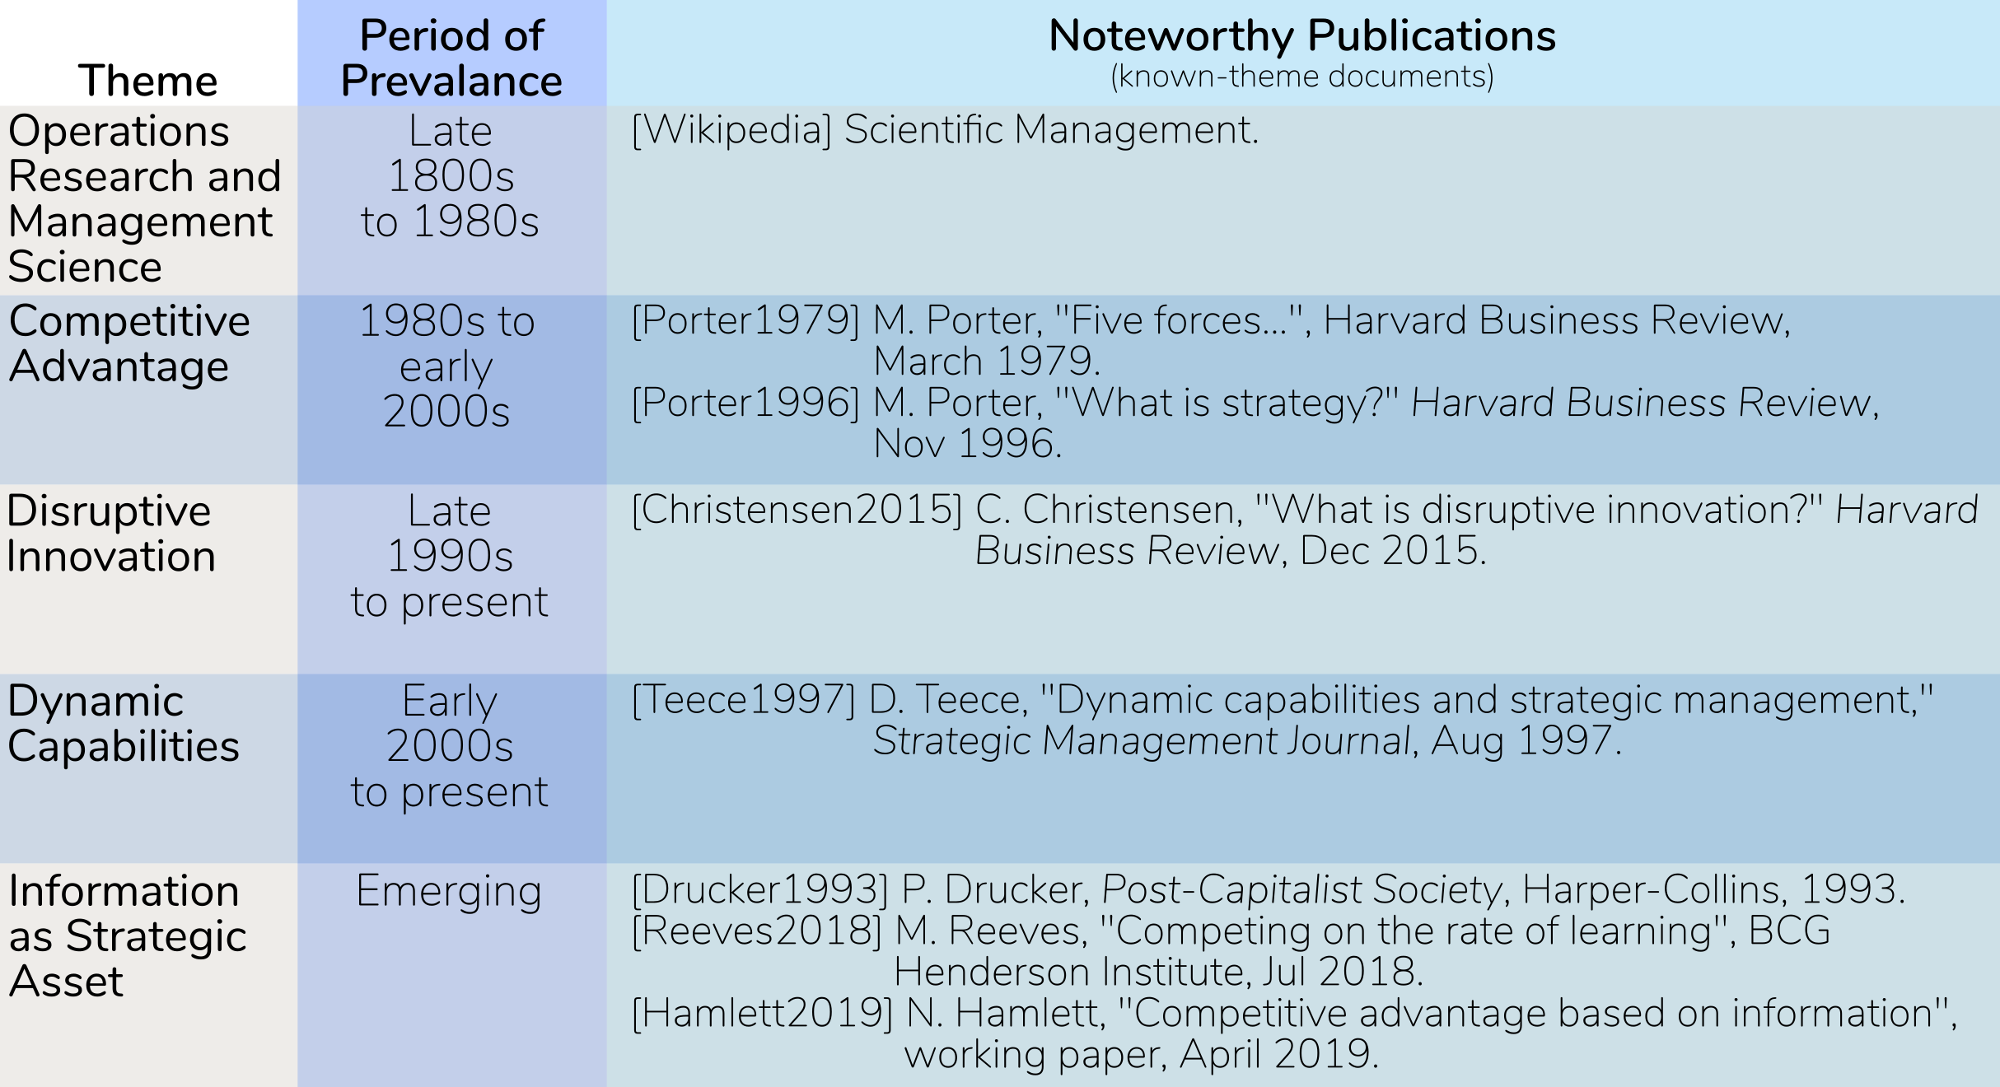
Key Business Problem: Five key themes dominated the business-strategy research over the last century. Can we detect them using machine-learning methods?

Slide 4
What makes this problem challenging?
Fuzzy definitions of “strategy”.
Probably lots of the content that’s not completely on-point with major themes.
Significantly more recent content than earlier content.
Lots of editorial variation across journals.
Less than full-text: Working only with titles, abstracts (this phase only).
This type of problem is hard in general.
Personal learning curve for Spark-Scala.

Slide 5
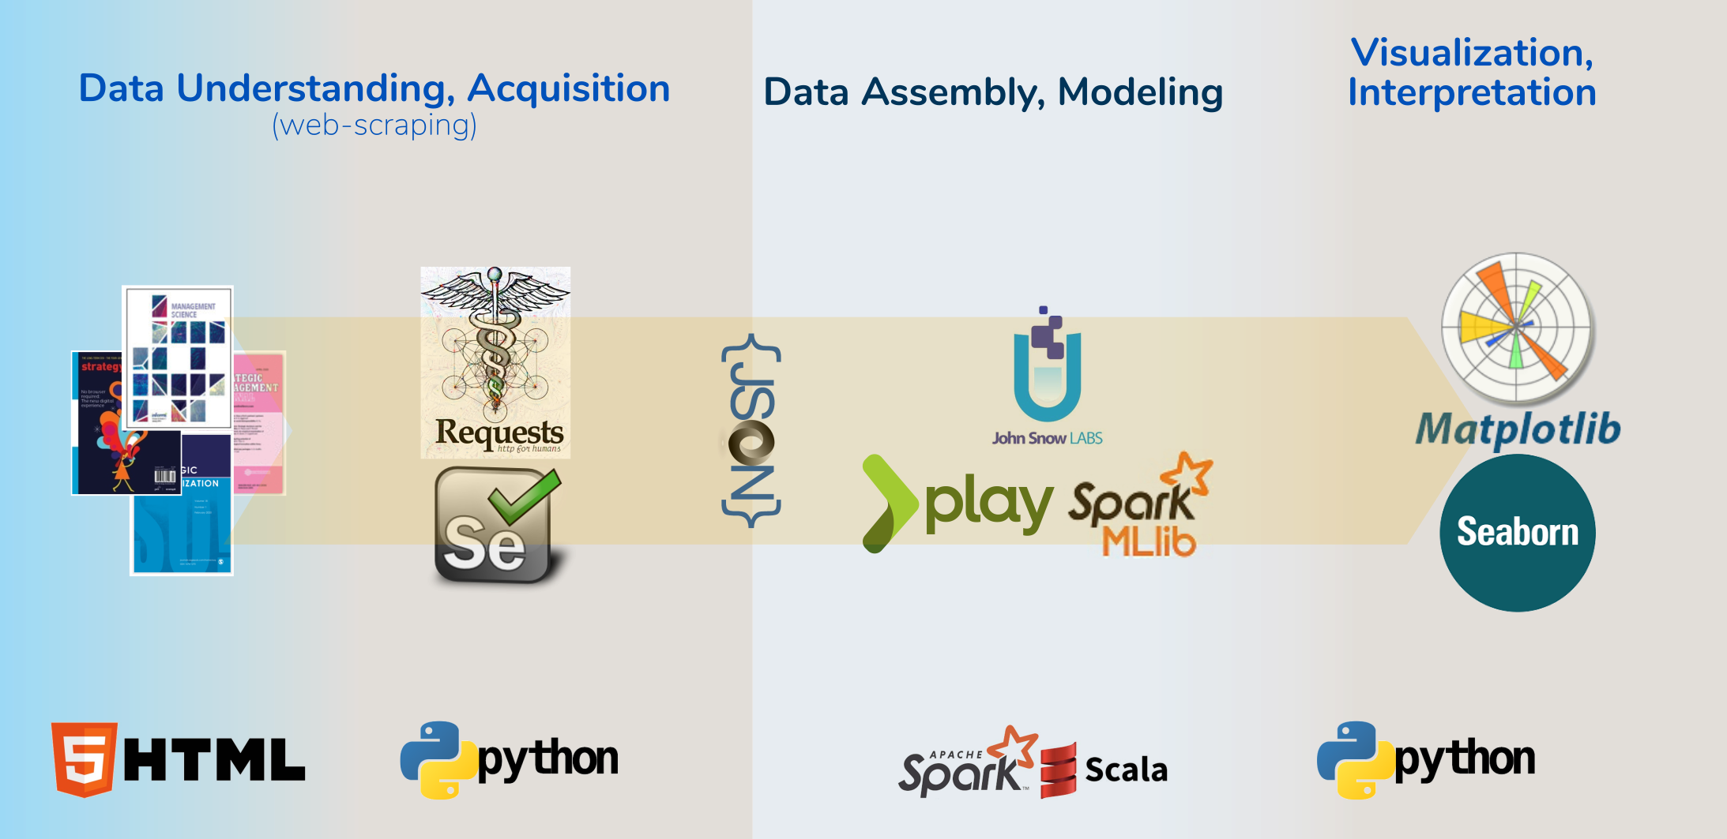
Tools: A mixture of technologies and methods was employed to produce the results.

Slide 6
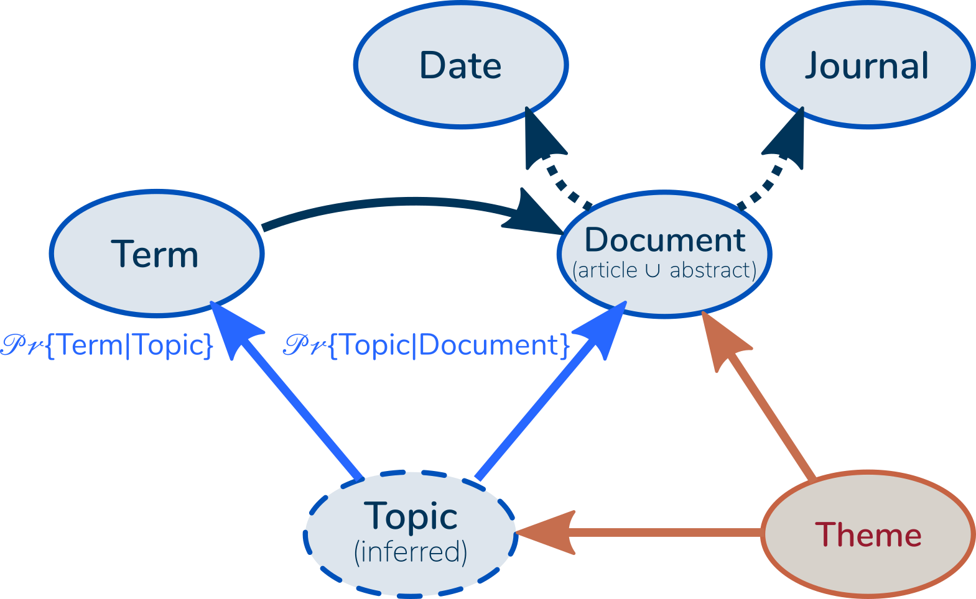
Modeling Approach: Latent Dirichlet Allocation (LDA) — a Bayesian unsupervised-learning method — is commonly used for topic analysis.
Latent: The Topic attribute is “latent”: Not directly observable.
Dirichlet: The Topic probabilities are described by Dirichlet probability distributions.
Allocation: We allocate our degrees of belief across all topics, not definitively assigning to one or another.

Slide 7
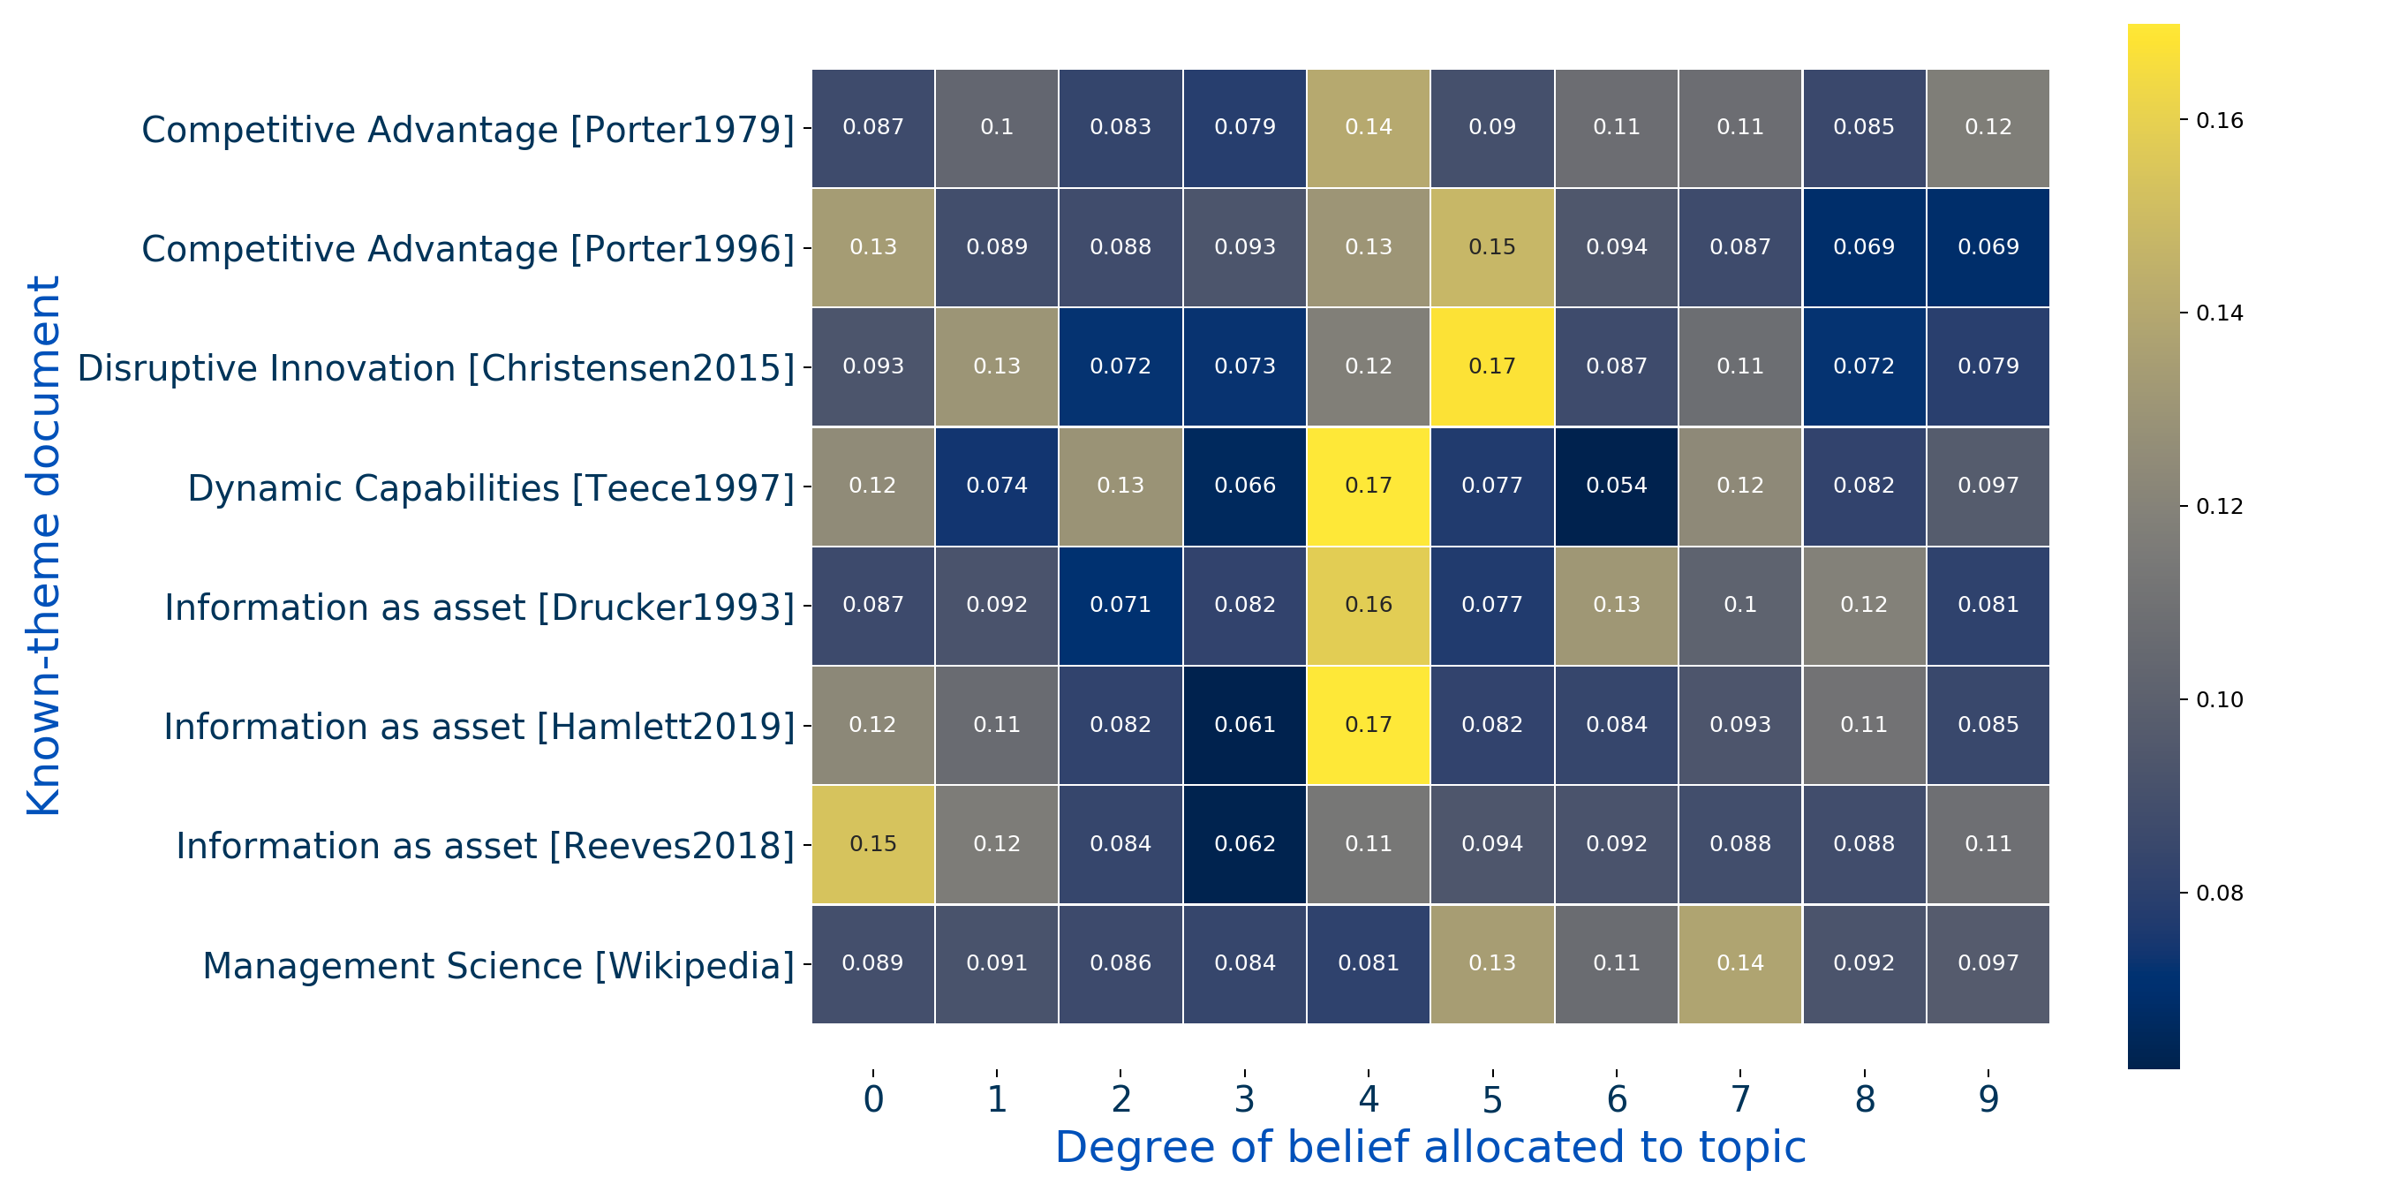
Key result: The model allocates degrees of belief 𝒫𝓇{Topic | Document} for each document across all topics.

Slide 8
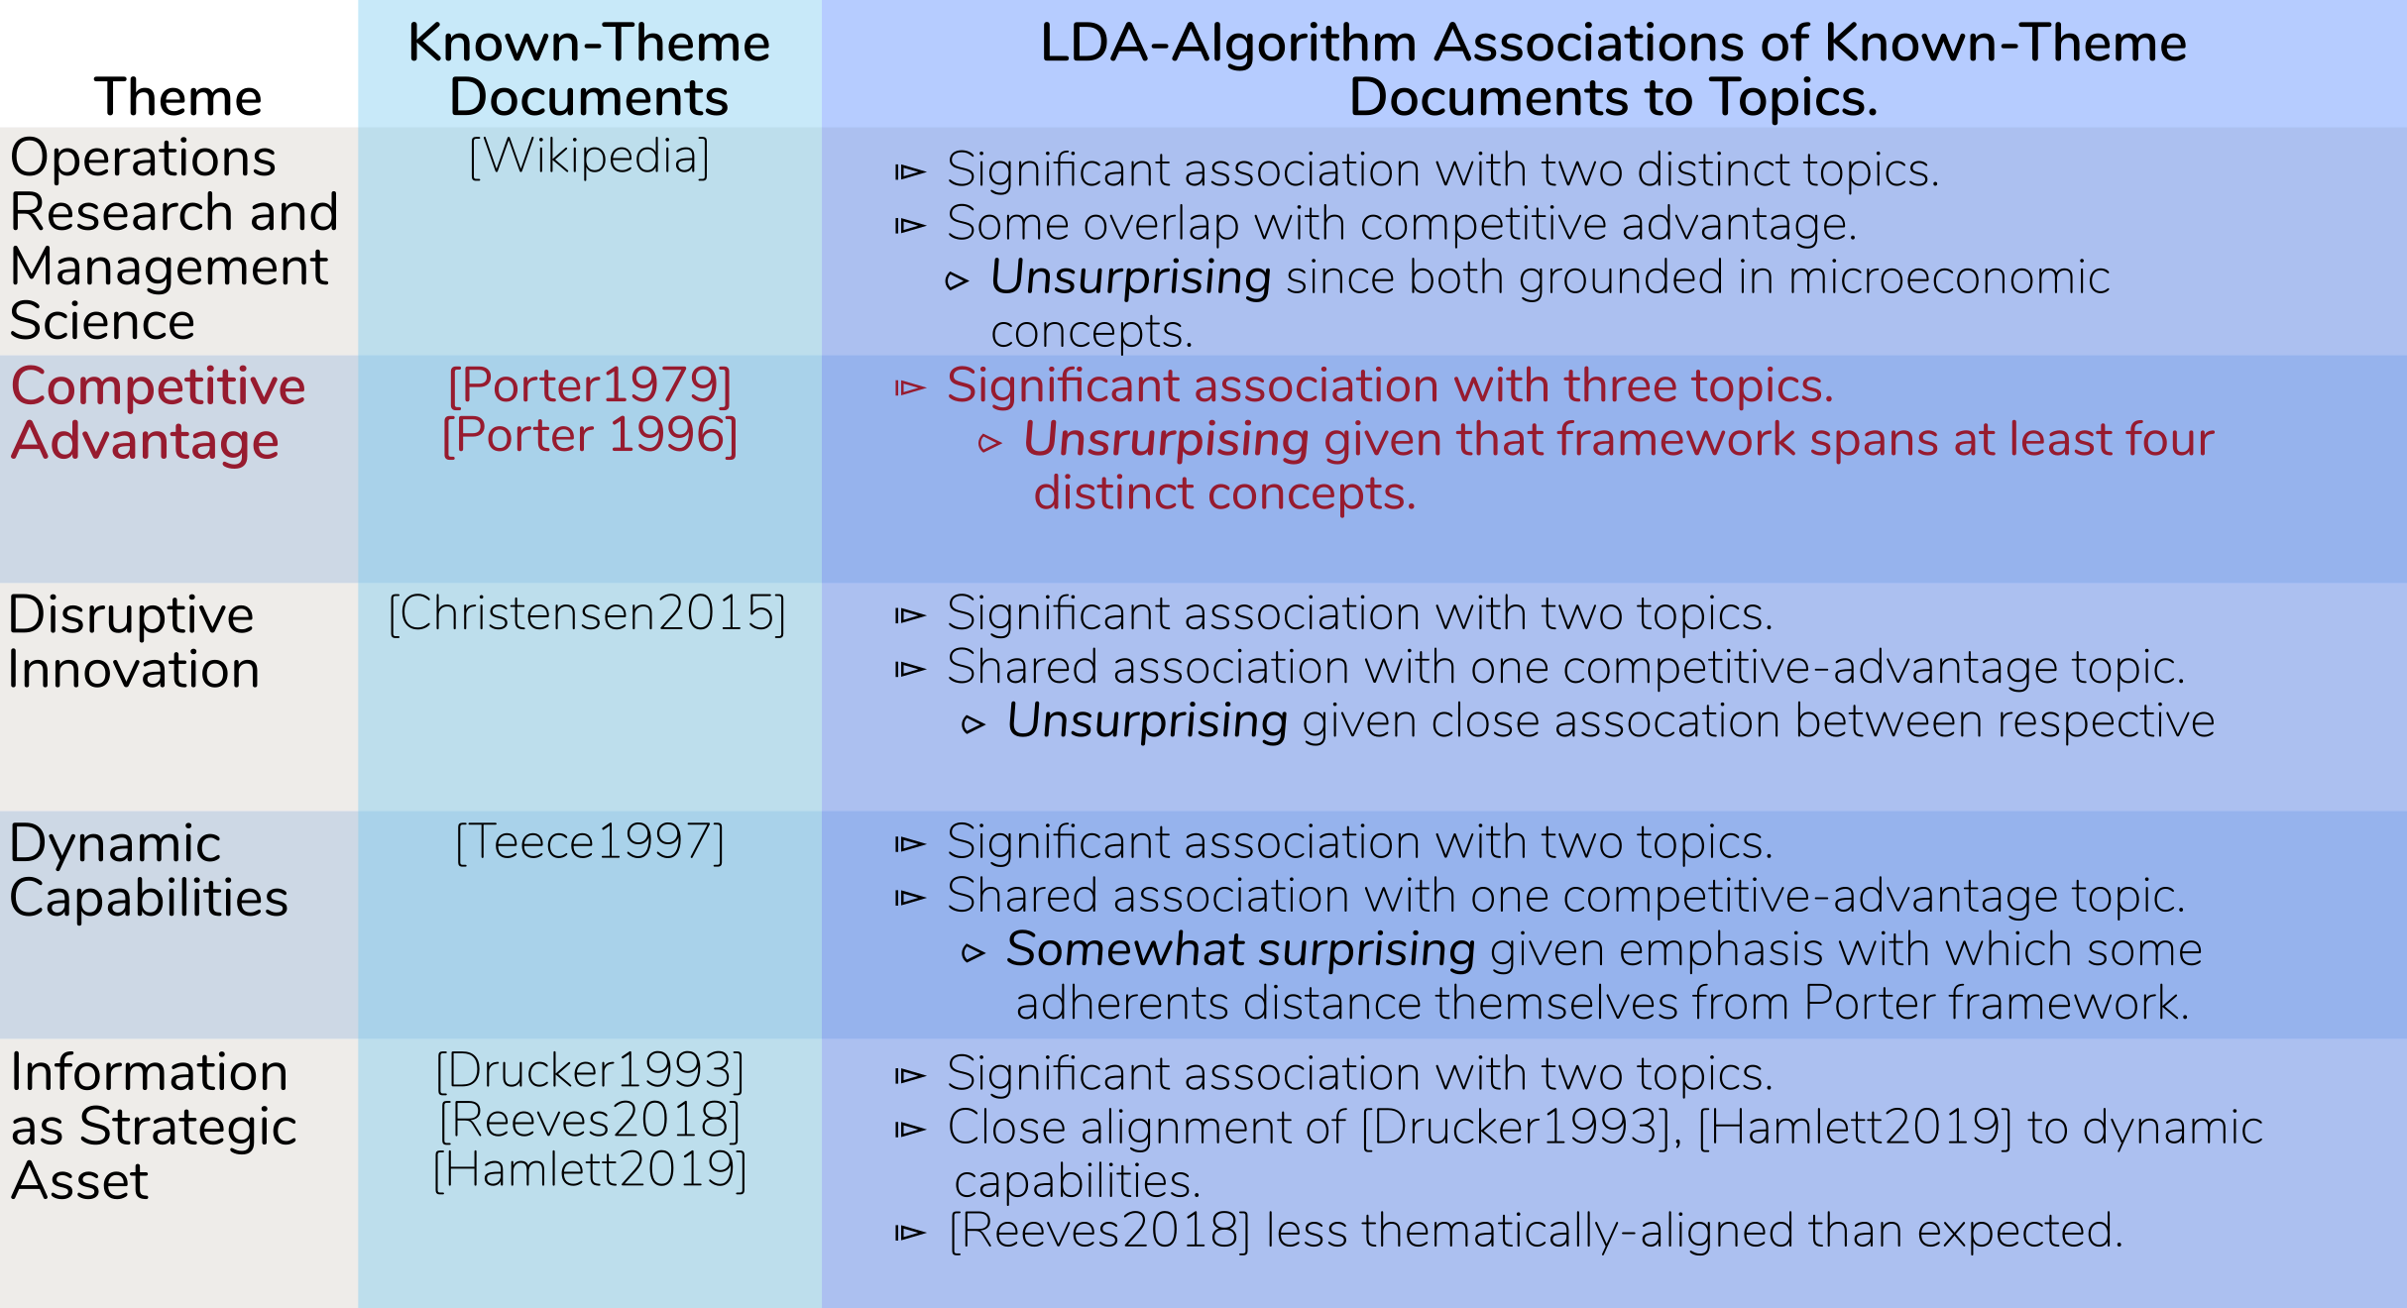
Conclusion: Strong associations exist between known-theme documents and topics, but we fail to distinguish between themes.

Slide 9
Further directions: INFORMS Annual Meeting 2020. (http://meetings2.informs.org/wordpress/nationalharbor2020/)
Harvest full-text articles.
Fewer journals, more text.
Possibly one previously-unused business magazine.
Increase the signal strength.
Move beyond stemming to lemmatization, part-of-speech tagging.
Explore improved algorithm scoring.
Look for a way to get “cleaner” topics.
Attempt to visualize the evolution over time.

Slide 10
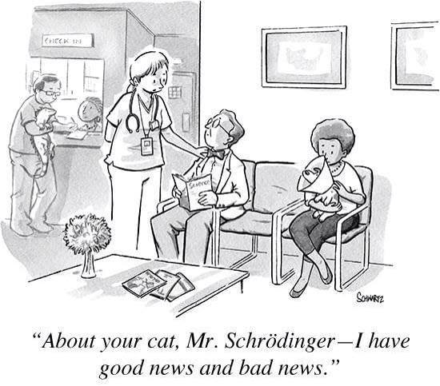
Questions?

Slide 11
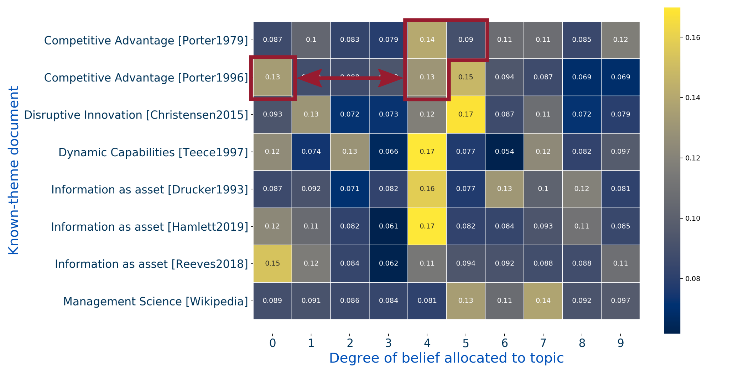
Theme ⓵: The Competitive-Advantage framework spans multiple topics.

Slide 12
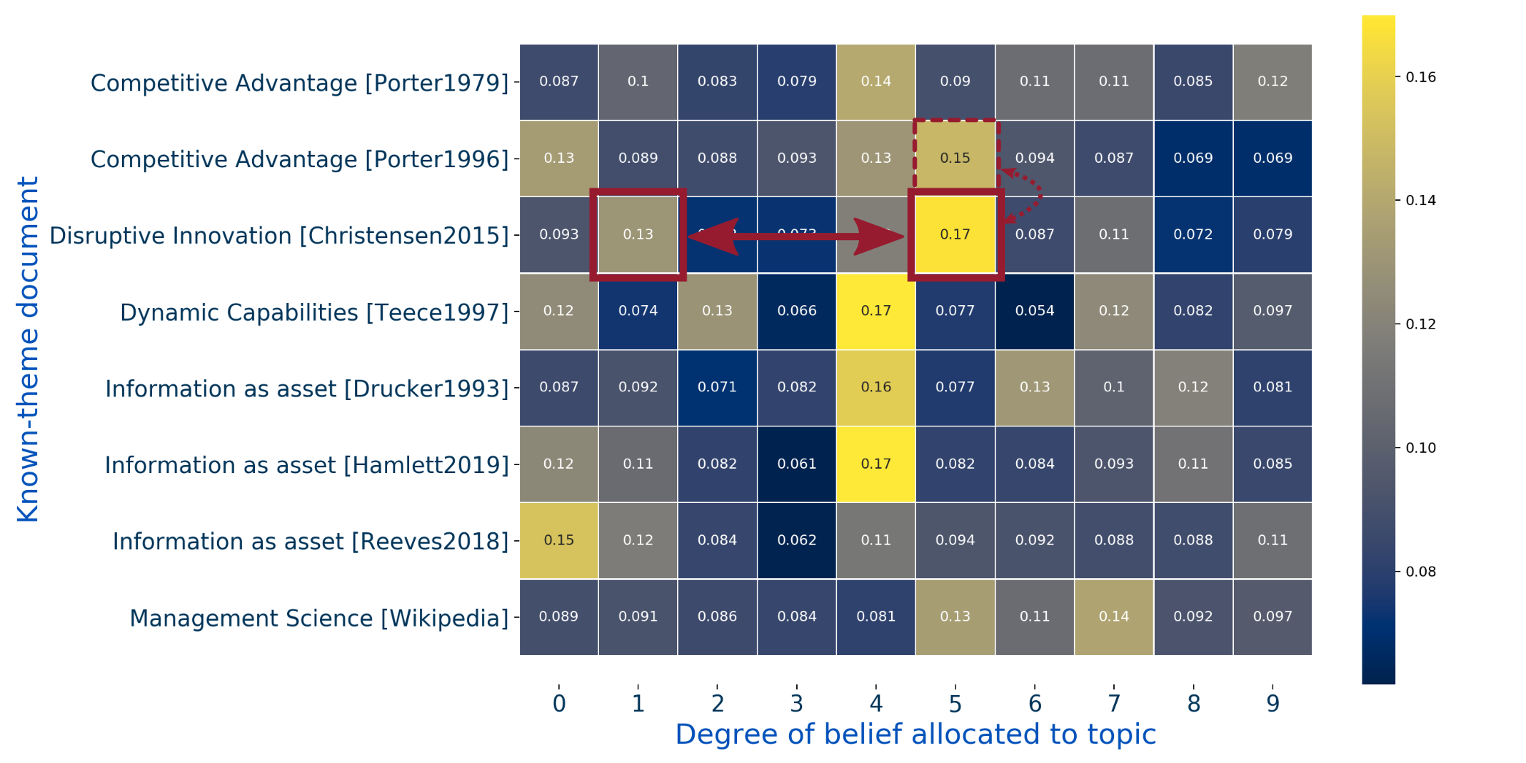
Theme ⓶: Disruptive Innovation overlaps with Competitive Advantage.

Slide 13

Theme ⓷: Dynamic Capabilities overlaps with some of Competitive Advantage’s strongest signals.

Slide 14
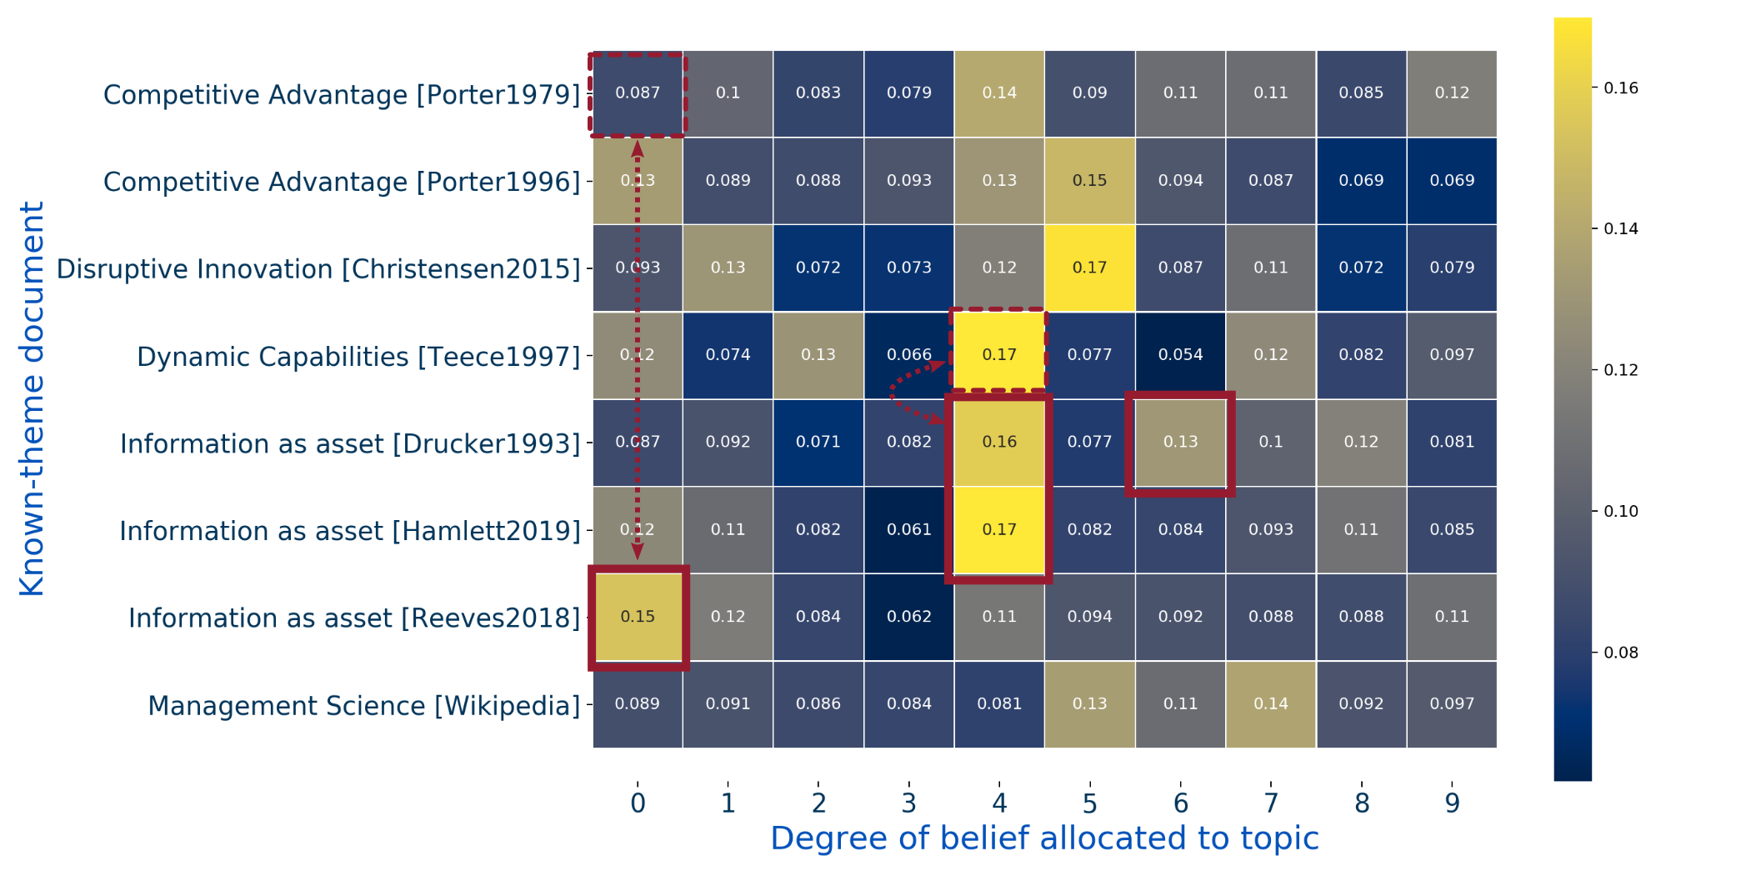
Theme ⓸: Information as an Asset is closely aligned to Dynamic Capabilities.

Slide 15
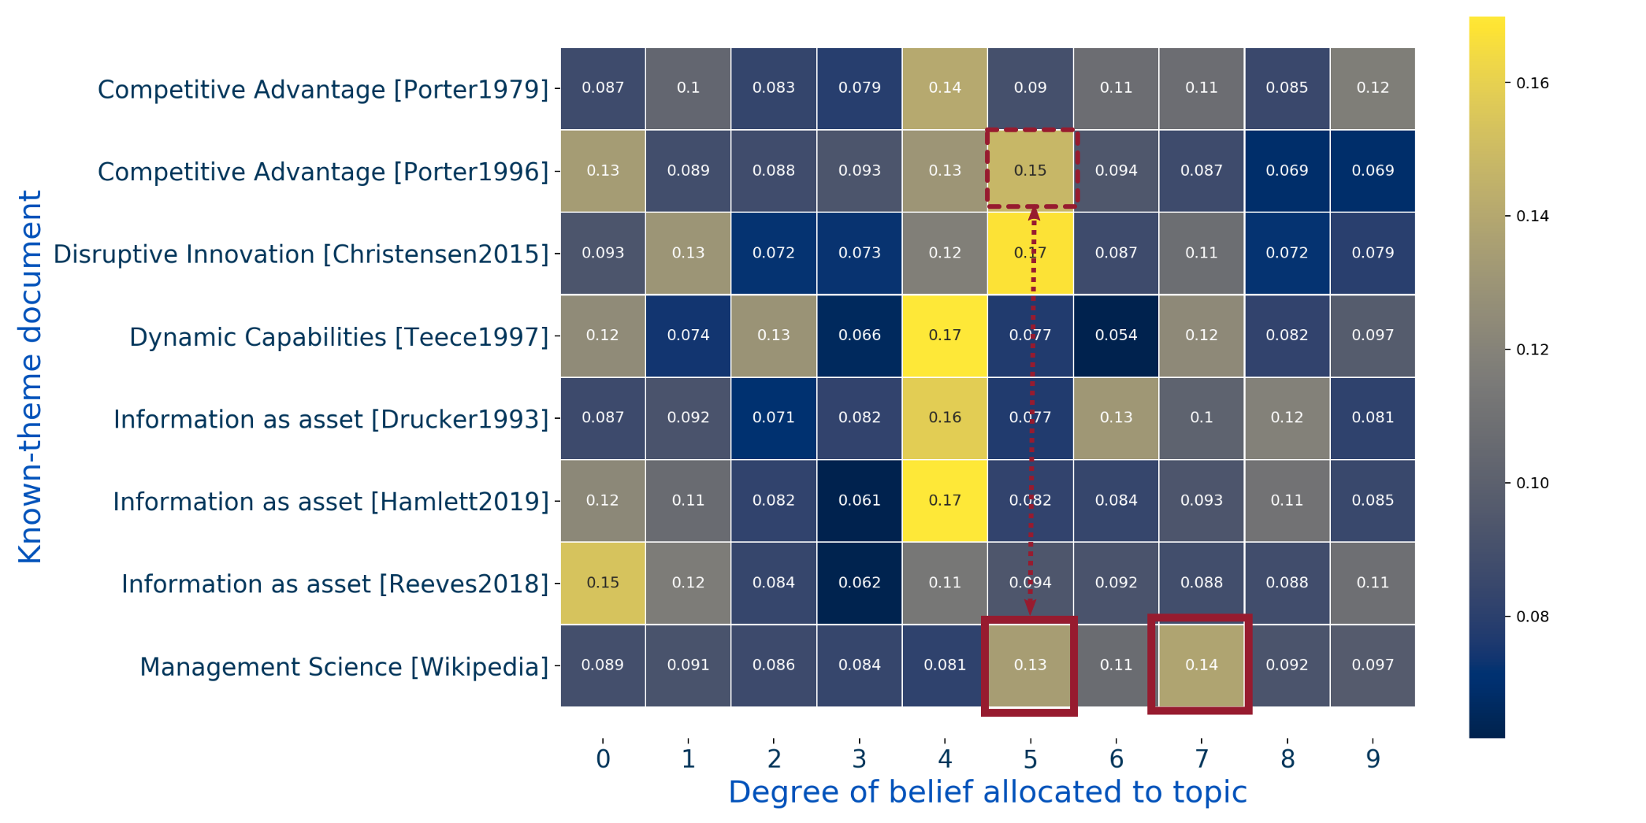
Theme ⓹: Management Science is largely distinct, with some overlap with Competitive Advantage.

Slide 16


